Slide 1
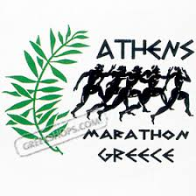
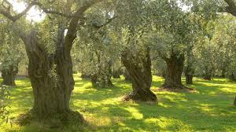
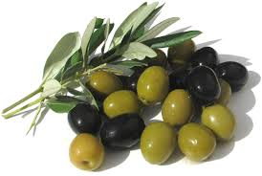
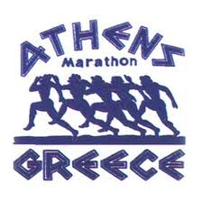
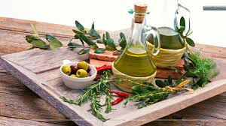
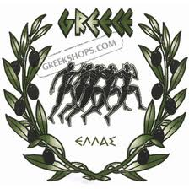
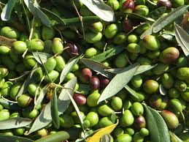
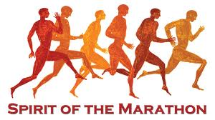
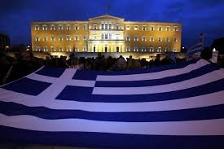
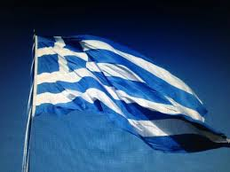
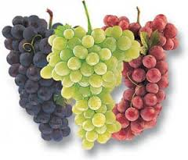
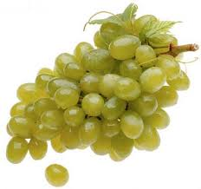
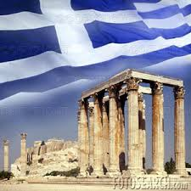

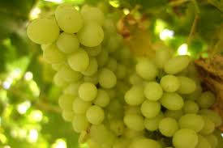
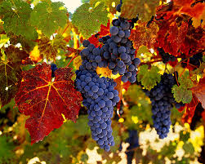
Autumn events in Greece

Slide 2
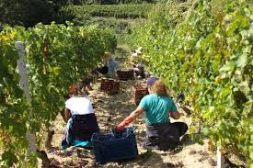
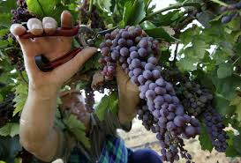
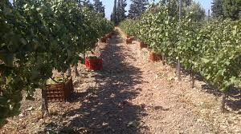
Grape Harvest

Slide 3
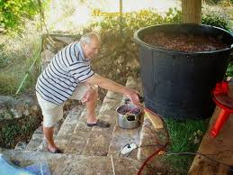
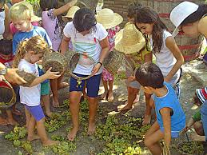
Grape Harvest
Harvest is the picking of grapes and in many ways the first step in wine production. Grapes are either harvested mechanically or by hand.

Slide 4
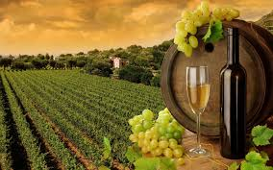
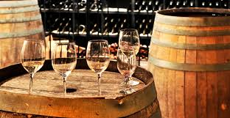
Grape Harvest
Grapes are usually harvested from the vineyard in Greece from early September until the beginning of November.

Slide 5
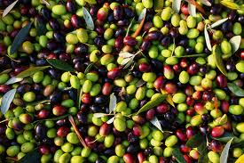
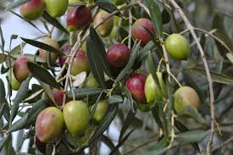
Olive Picking
In some places, the olive harvest starts as early as October when the fruit is still not mature but most olives are harvested starting in November, just as the fruit turns from greenish to purple-black.

Slide 6
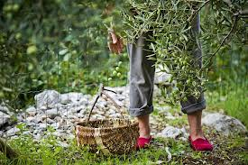
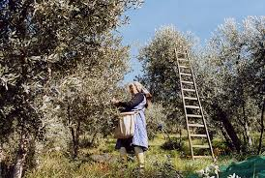
Olive Picking
Nowadays, the olive harvest is mechanical and special portable equipment is used. However, many continue with the traditional way of beating the olives from the branches.

Slide 7
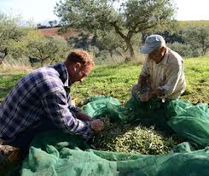
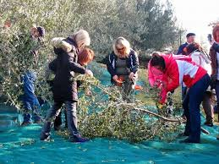
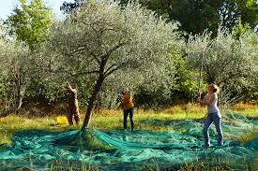
Olive Picking
Special nets or big pieces of synthetic fabric are placed under the trees. Their use is to collect the olives that drop from the tree.

Slide 8
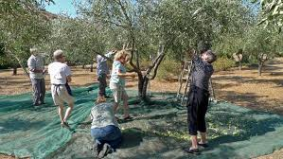
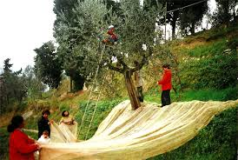
Olive Picking
It is very common for relatives and friends to help each other for the olive harvest. Everything has to be done efficiently and fast because the whole procedure is weather dependant.

Slide 9

28th of October

Slide 10
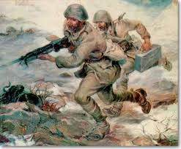
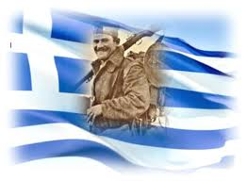
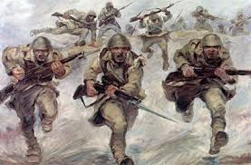
28th of October
Ohi Day is celebrated throughout Greece, Cyprus and the Greek communities around the world on October 28 each year, to commemorate the rejection by Greek Prime Minister Ioannis Metaxas of the ultimatum delivered by Italian dictator Benito Mussolini on October 28, 1940.

Slide 11
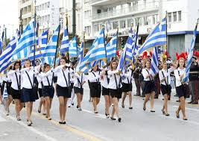
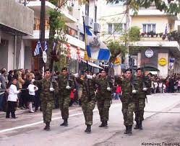
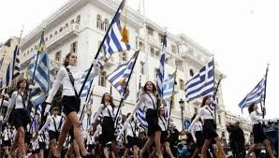
28th of October
During the war, October 28 was commemorated yearly by Greek communities around the world and in Greece and Cyprus, and after World War II it became a public holiday in Greece and Cyprus. The events of 1940 are commemorated every year with military and student parades. On every anniversary, most public buildings and residences are decorated with Greek flags.

Slide 12
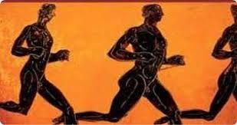
Marathon

Slide 13
Marathon
The Marathon is a long distance running event with an official distance of 42.195 km, usually run as a road race.
The event was instituted in commemoration of the fabled run of the Greek soldier Pheidippides, a messenger from the battle of Marathon to Athens.

Slide 14
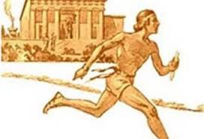
Marathon
The legend states that he was sent from the battlefield of Marathon to Athens to announce that the Persians had been defeated in the battle of Marathon which took place in 490 BC.
It is said that he ran the entire distance without stopping and burst into the assembly exclaiming ν ε ν ι κ ή κ α μ ε ν
(nenikekamen, we have won)
before collapsing and dying.

Slide 15
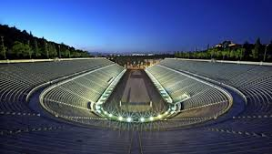
Marathon
The Athens Classic Marathon is an annual road race held in Athens normally in early November.
It starts at the ancient battlefield in the town of Marathon and finishes at the Panathenaic stadium, the beautiful marble stadium in which the first modern Olympics were held in 1896.

Slide 16
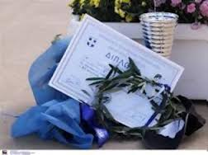
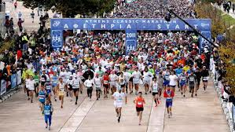
Marathon
Today, Marathons have become a running tradition throughout the world. Yet the annual Marathon at Athens, where it all began has a tradition and an appeal like no others.

Slide 17
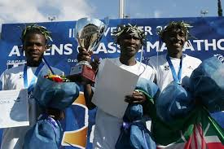
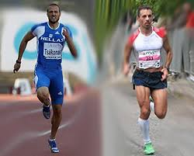
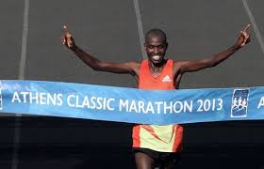
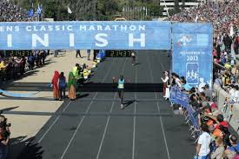
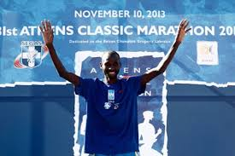
Marathon
Great athletes and runners from all over the world come to Athens every year and take part in this glorious event.

Slide 18


Slide 19
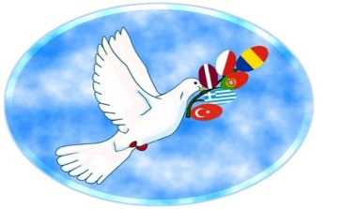

Comenius Peace Project 2013-2015
People Events Around Countries of Europe
This project has been funded with support from the European Commission. This publication [communication] reflects the views only of the author, and the Commission cannot be held responsible for any use which may be made of the information contained therein.
Kalliopi Chantzi, English teacher
Gymnasio Gastounis

