Slide 1

Music Festivals in Turkey

Slide 2
Turkey is a popular destination for the international music festivals and concerts, with everything from blues music festivals to stadium rock concerts making their way here..

Slide 3
International Ankara Music Festival
Ankara shows the world its importance as a major cultural center each year during this international event. There are orchestral performances, chamber music, and Turkish contemporary artists playing traditional and folk music from all over the world.

Slide 4
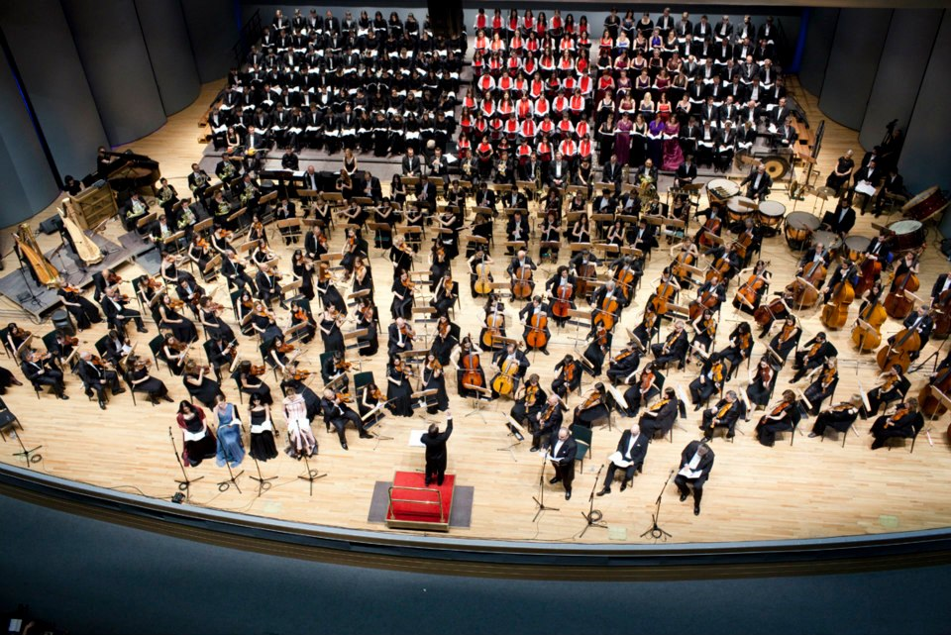

Slide 5
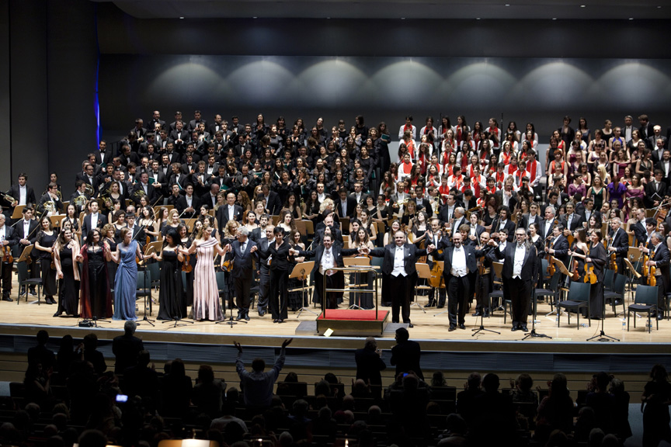

Slide 6
International İstanbul Music Festival
This world-class festival features big names in classical, opera, and ballet. Past artists have included La Scala Philharmonic, the Royal Concertgebouw Orchestra, the Tokyo String Quartet, Itzhak Perlman, Idil Biret, and Burhan Öçal.

Slide 7
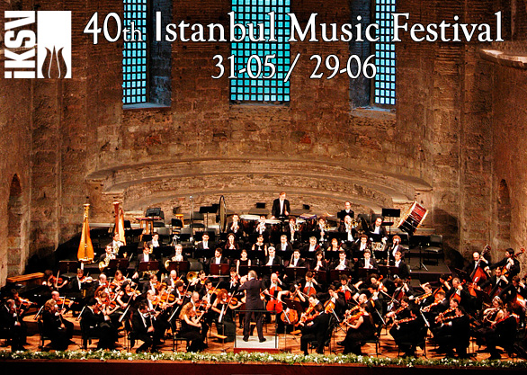

Slide 8
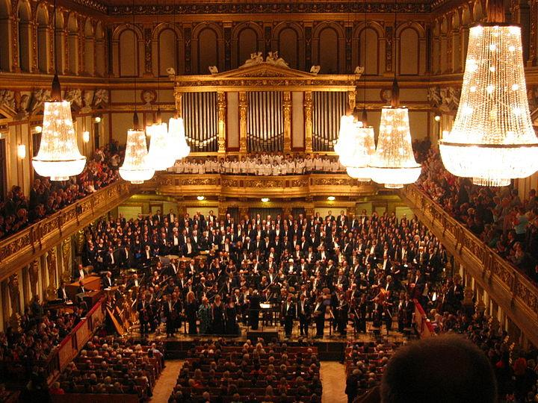

Slide 9
International Jazz Festival – İstanbul
Performances are held at various locations around the city.

Slide 10
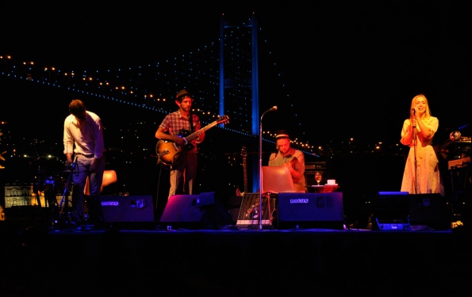

Slide 11
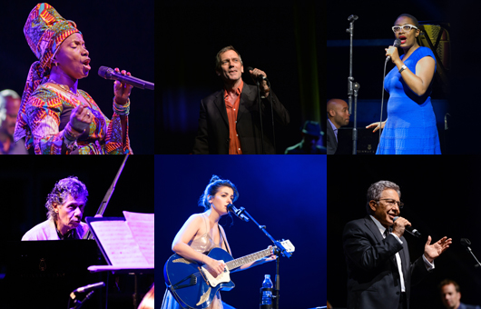

Slide 12
Akbank Jazz Festival
This 2-week-long festival brings the blues simultaneously to Istanbul, Ankara, and Izmir. Now in its 17th season, the festival hosts world-renowned performers in the cities' most atmospheric venues

Slide 13


Slide 14
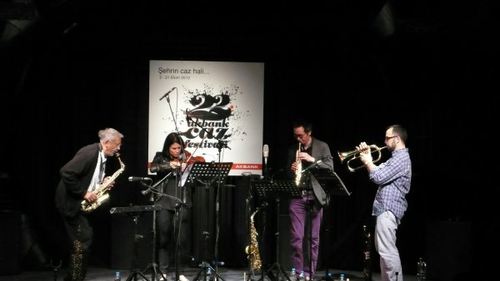

Slide 15
Efes Pilsen Blues Festival
In its 20th year as of 2010, this touring blues extravaganza transports Turks to America's deep South -- at least in spirit -- by way of performers who, in recent years, have included John Lee Hooker, Bernard Allison, John Primer, Adophus Bell, Luther Johnson, and Jerry Ricks. Shows are scheduled for Istanbul, Ankara, Izmir, Bursa, Çanakkale, Kayseri, Denizli, and Konya

Slide 16


Slide 17


Slide 18
Aspendos International Opera Festival
The magic of the Aspendos International Opera and Ballet Festival in June owes much to the magical atmosphere of the 2,000-year-old Aspendos Amphitheatre. This ancient Roman amphitheatre can seat between 4000 to 6000 spectators and is beautifully illuminated during night-time events.

Slide 19
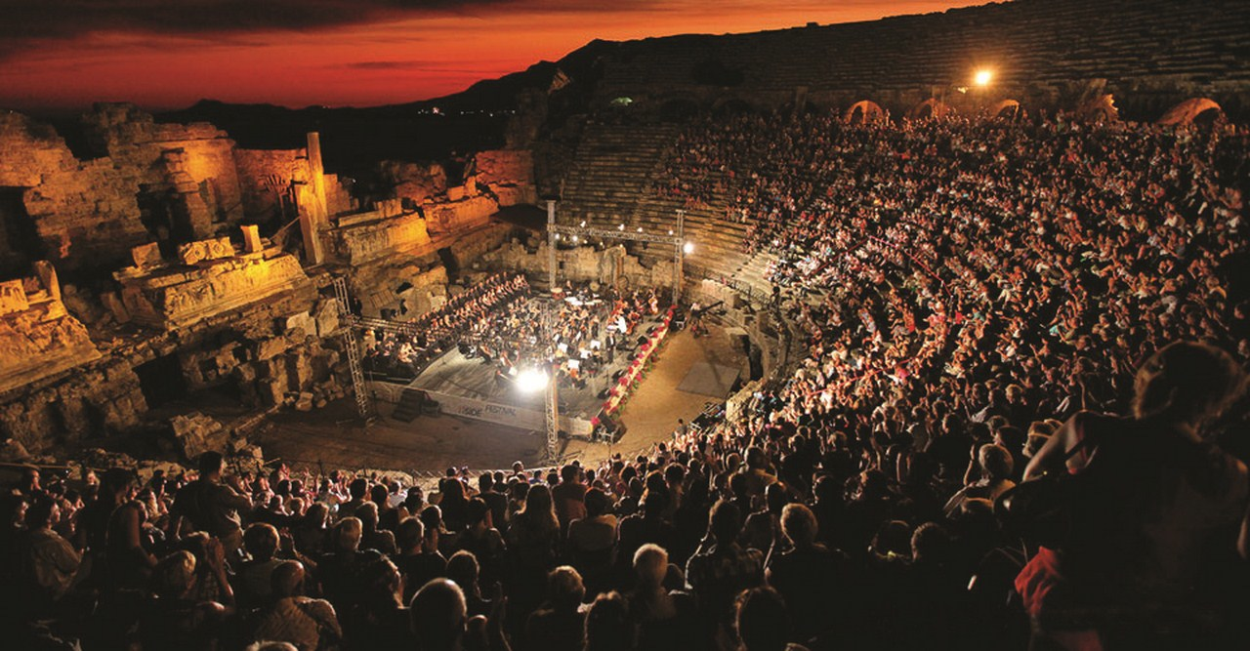

Slide 20
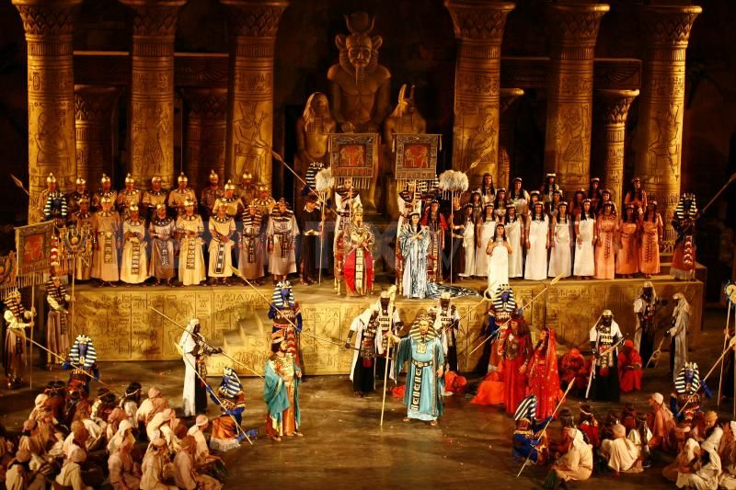

Slide 21
Rock’n Coke
Rock'n Coke is a member of the European Festivals Association. At the end of every summer, the Hezarfen Airfield is used as a venue for a two day chain of concerts, with both national and international performers featured

Slide 22


Slide 23
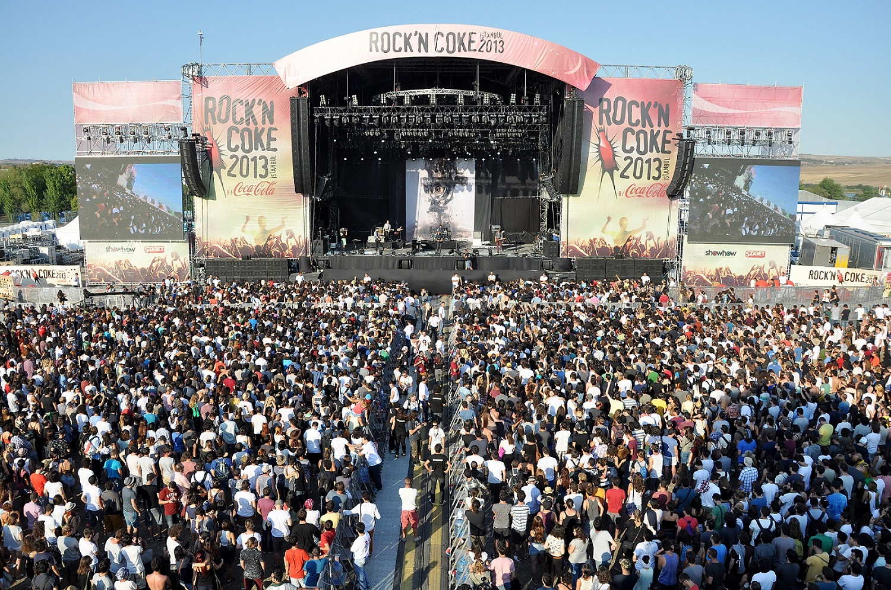

Slide 24
Did you like the background music?

Slide 25
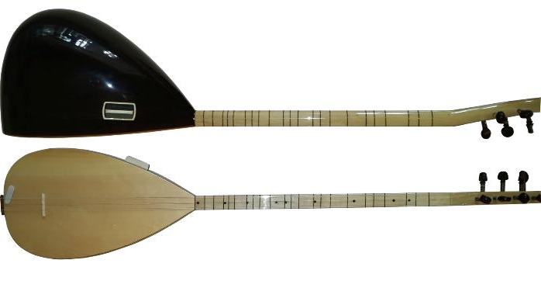
Neşet Ertaş (1938 – 25 September 2012) was a Turkish folk music singer, lyricist, and virtuoso of the traditional Turkish instrument the bağlama. His profession in Turkish is known as halk ozanı, which literally means "folk bard".

Slide 26
In 2010, Neşet Ertaş was honoured with the UNESCO "National Living Human Treasure" award
Although we don’t have an international event for Neşet Ertaş, he is one of the most well-known folk singer in Turkey and we want to show our respect to him by mentioning and introducing him to you in our presentation.

Slide 27
Thanks for listening

